Slide 1
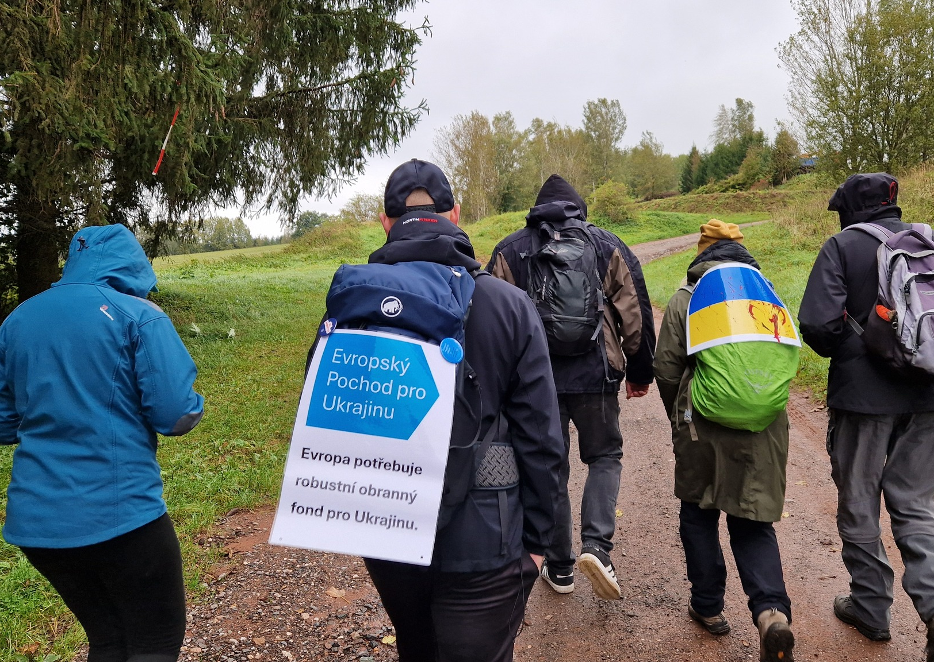
European March for Ukraine

Slide 2
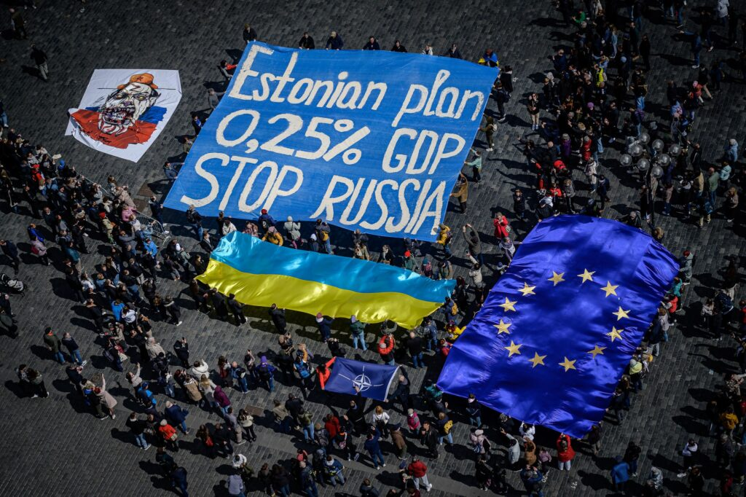
Inspiration and pilot marches
We are following our previous larger event – Estonian plan for Ukraine flashmob in Prague.
And 2 pilot marches in cooperation with initiative across Czech republic in October.
3-day march from Česká Lípa to Prague.
March from Trutnov to Hrádeček (cottage of Václav Havel) this time dedicated to Ukraine.

Slide 3
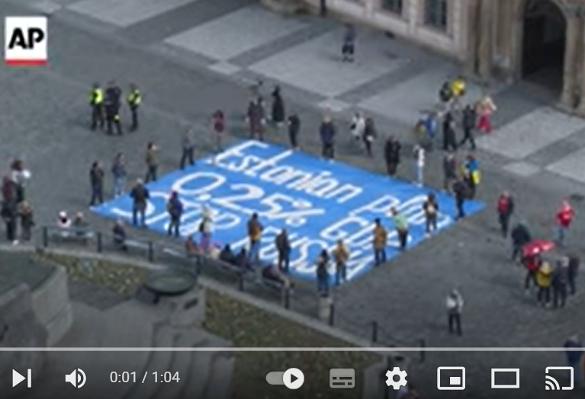
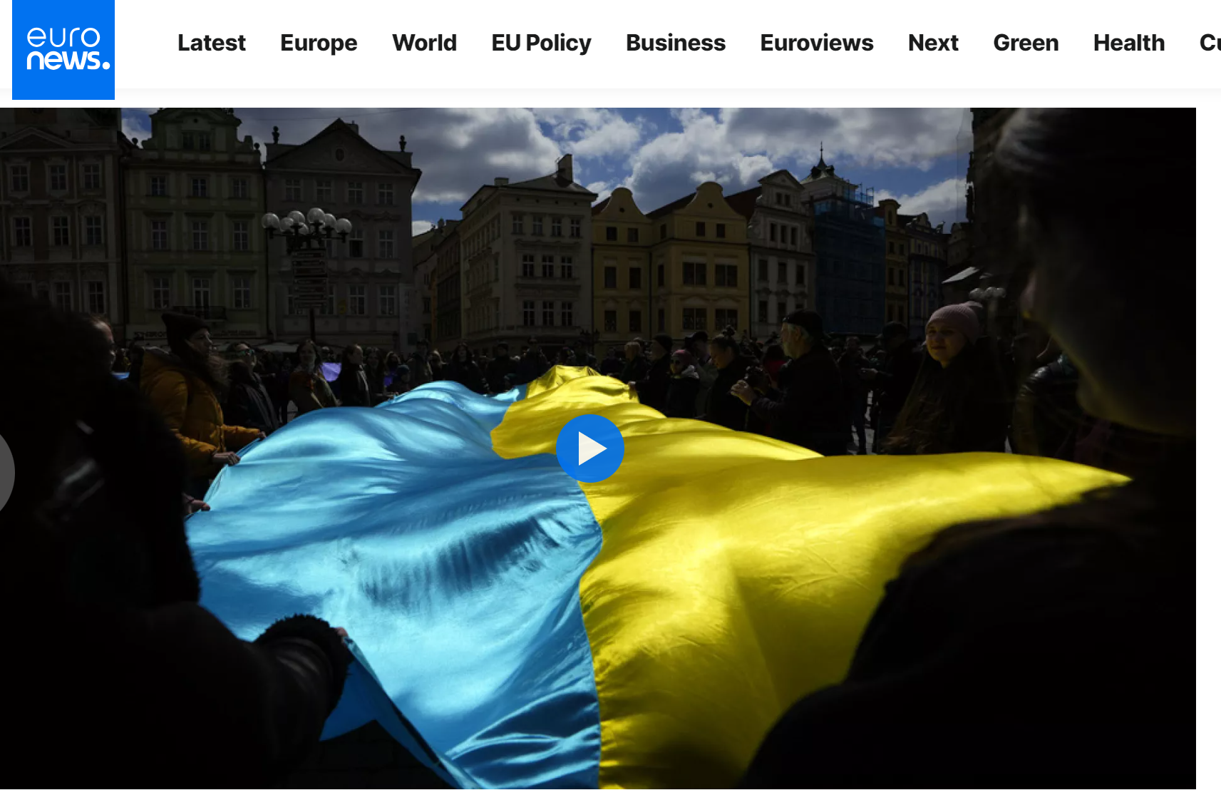
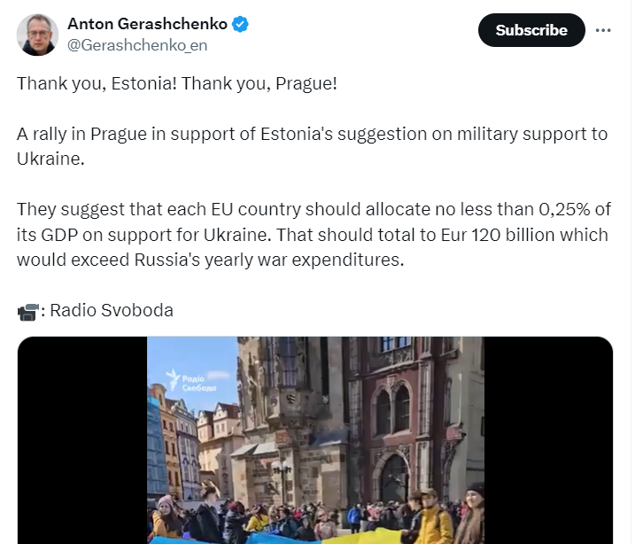
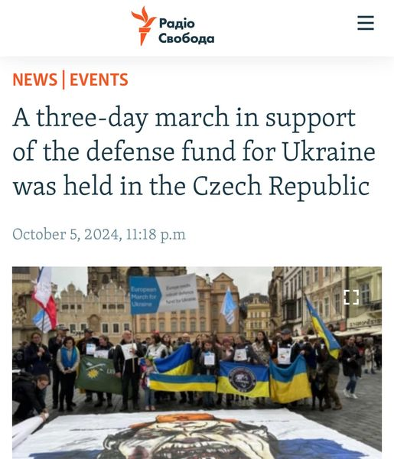
Pilot events in news:
Sources: FB European March for Ukraine / Estonian plan event

Slide 4
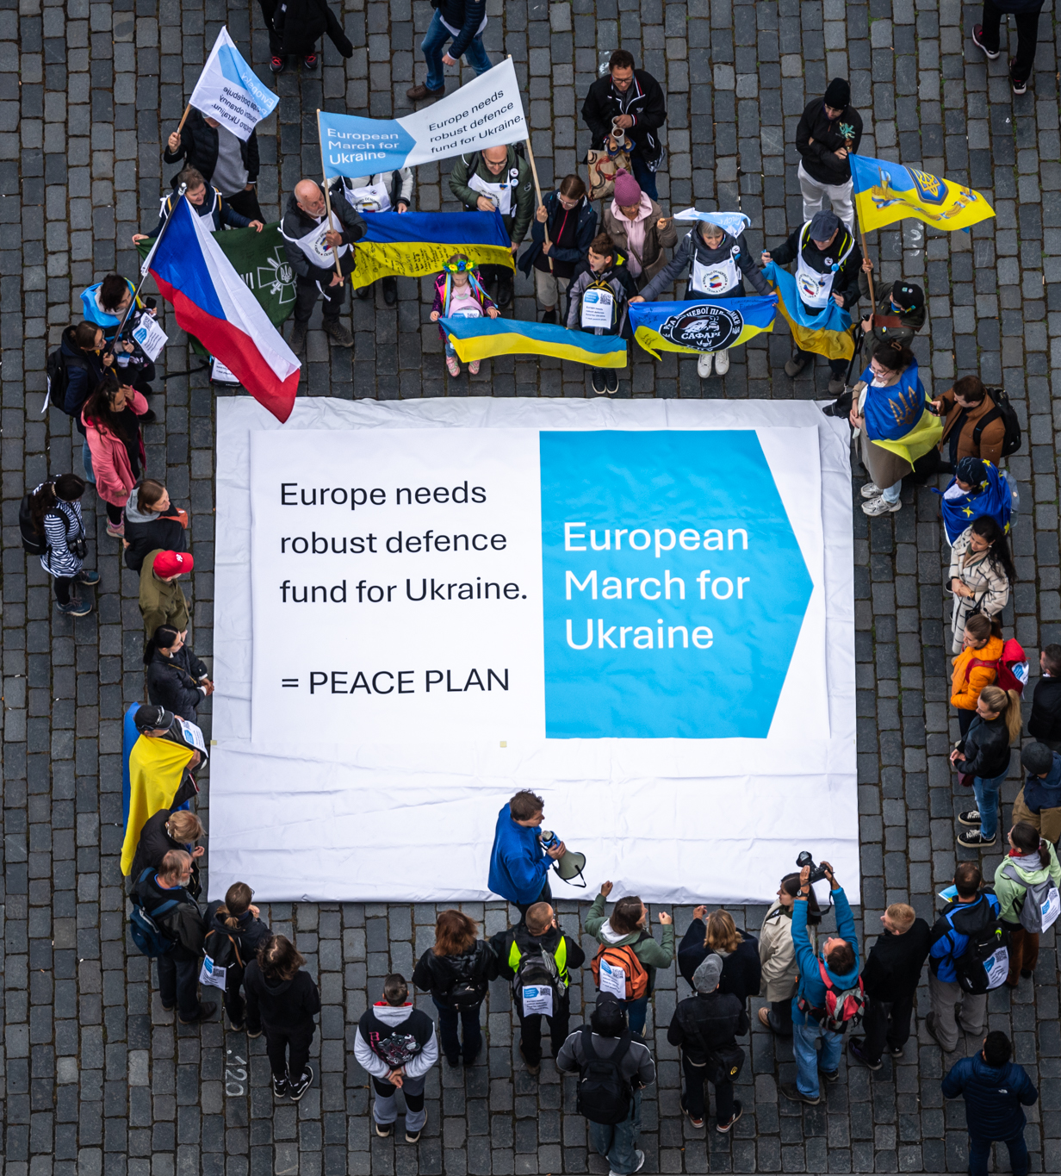
Goal of European March for Ukraine
We promote the idea that European countries should create robust joint defense fund for Ukraine = for Europe.
We shall use detterence by economical power – as Estonian plan says (0,25% western GDP per year as military support of Ukraine). European countries can borrow such amount (100B euro) on financial markets as they did after pandemic (800B euro). Russia cannot do this and is economically much smaller.
This is realistic path for peace and in line with Estonian plan and Draghi proposal.

Slide 5
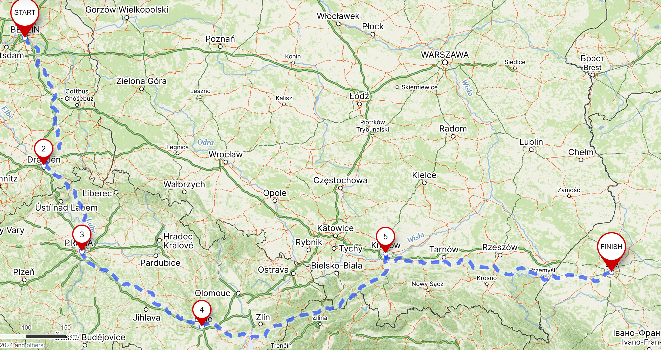
Preliminary route of the proposed long march (from Berlin to Lviv)

Slide 6
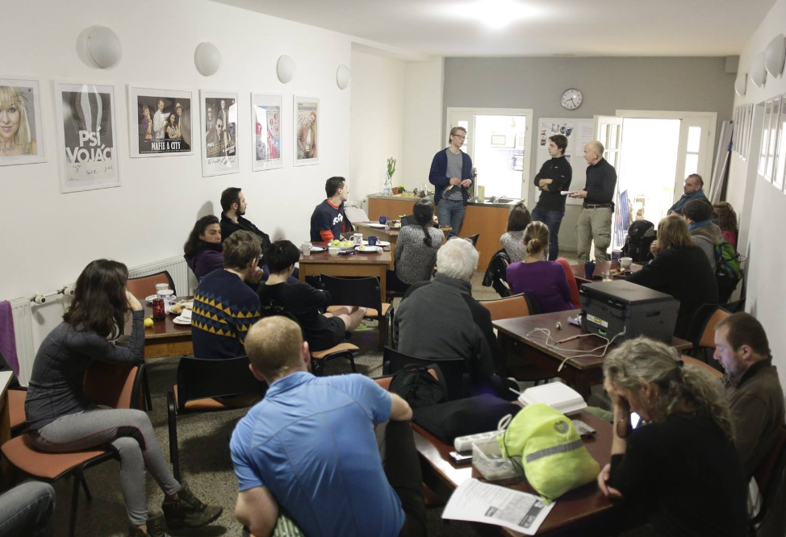
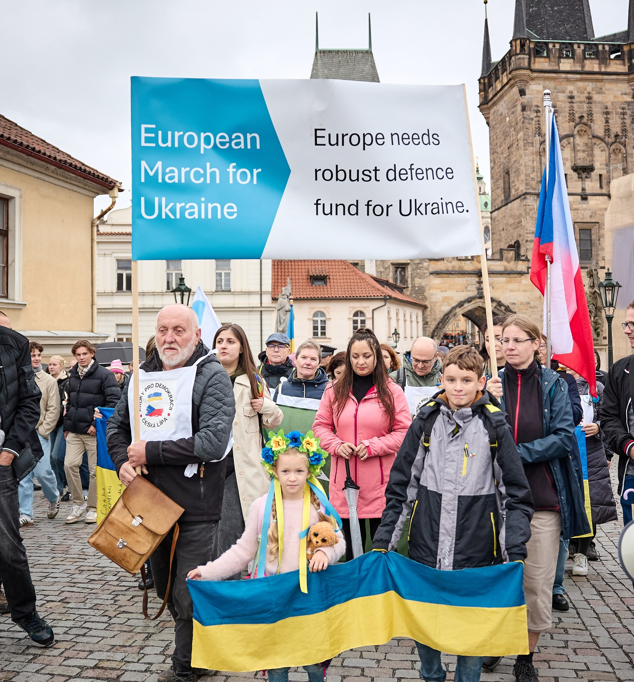
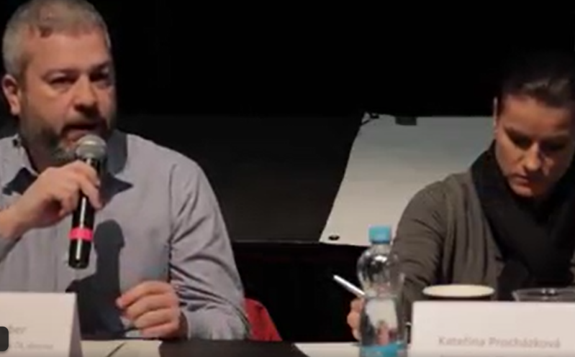
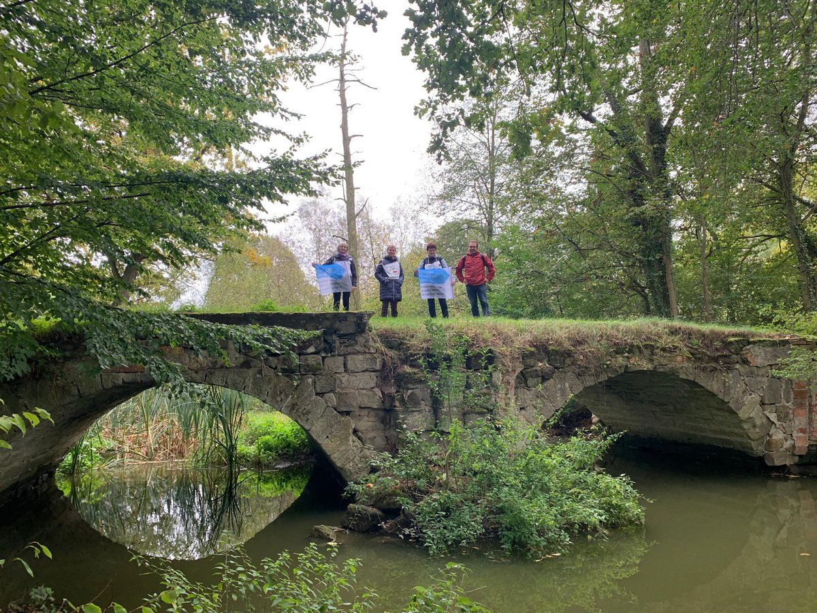
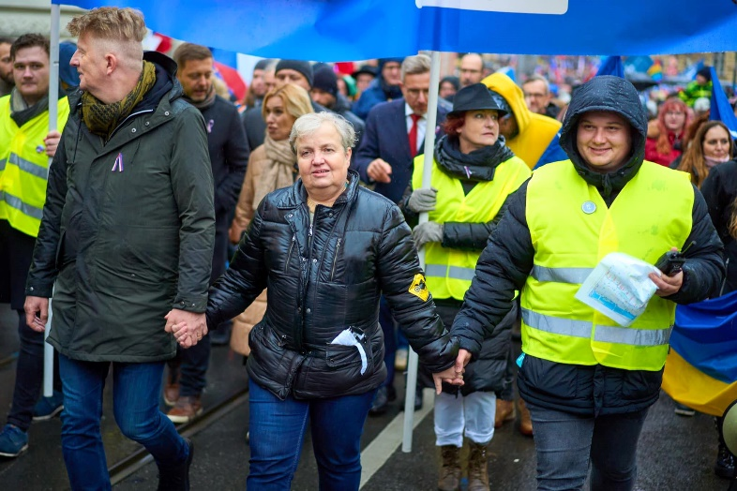
Ideas for stops on the way - European March for Ukraine
Press conferences
Street marches / city rallies
Panel discussions
March pictures in nature
Walks with well-known people

Slide 7
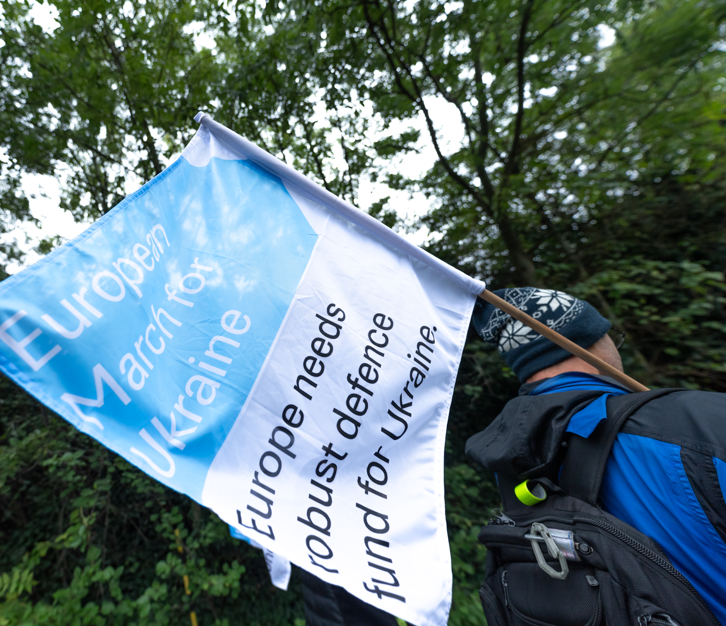
European March for Ukraine: main features
Main advantage: interesting idea almost for everyone. It can really raise awareness and help improve defense of Europe (Ukraine at the frontline) in critical times. It is a powerful tool, fresh for public and media – bringing stories of participants and their motivation.
Concerns and countermeasures: Main question seems to be if we can find enough participants for enough time. But nobody needs to walk all distance – we can split it to short sections. People can join around their city for 1-2 days.
For that, we are looking for organizers and walkers. Please follow our webpage for registering your possible help.

Slide 8
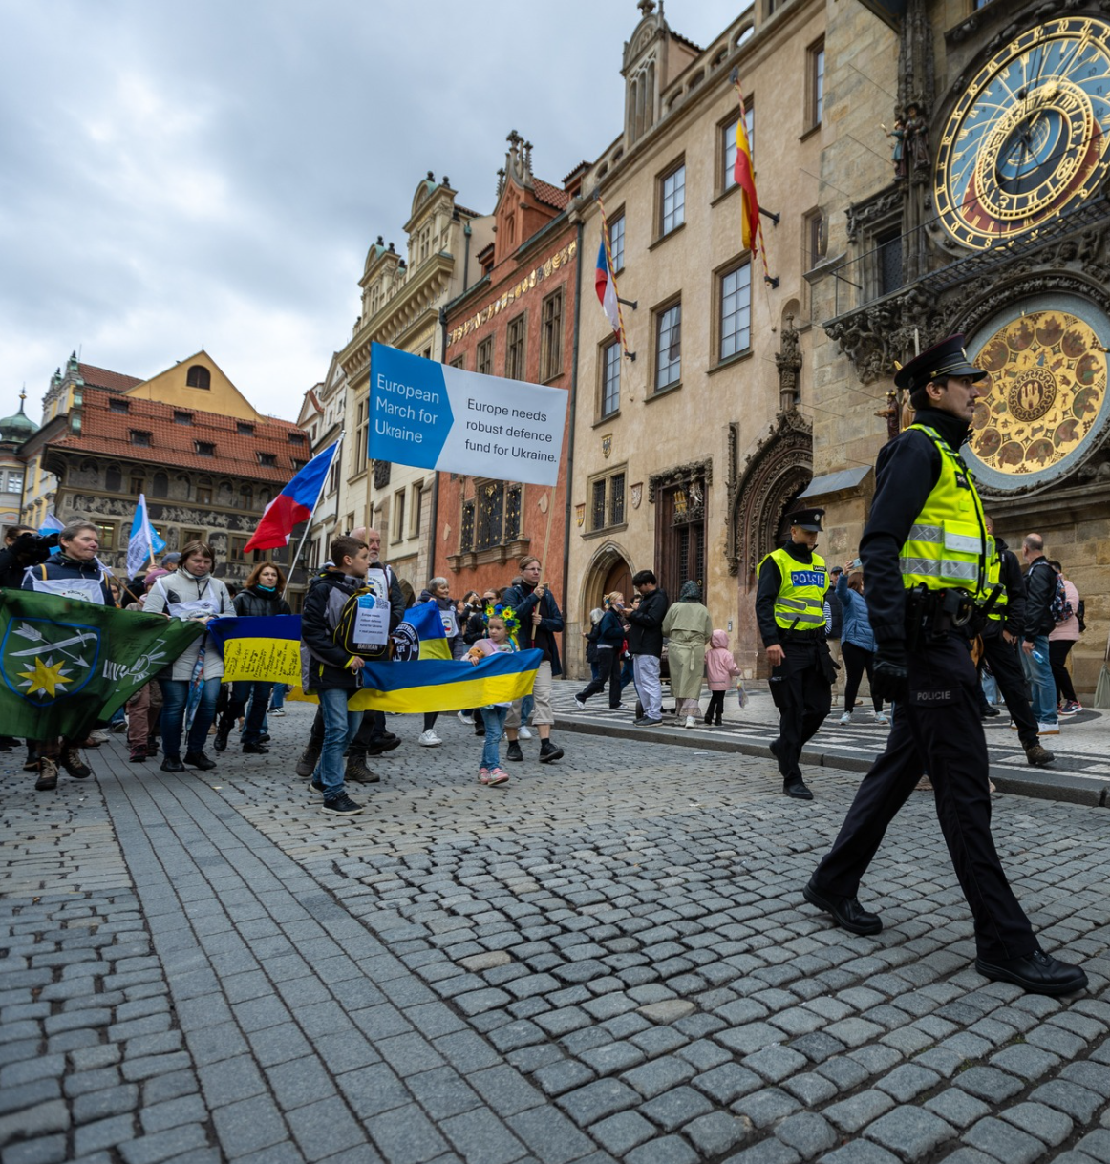
European March for Ukraine 2024/2025
Possible timings:
In spring the latest, possible around 24.2.2025
Or be ready for any event triggering such public attention that it needs such massive and inovative citizen action
Objective:
Support joint fund for European = Ukrainian defense (Estonian plan).
Q&A section on our webpage
Questions and answers - goals and practical matters
Join us:
marchforukraine.net

