Slide 1
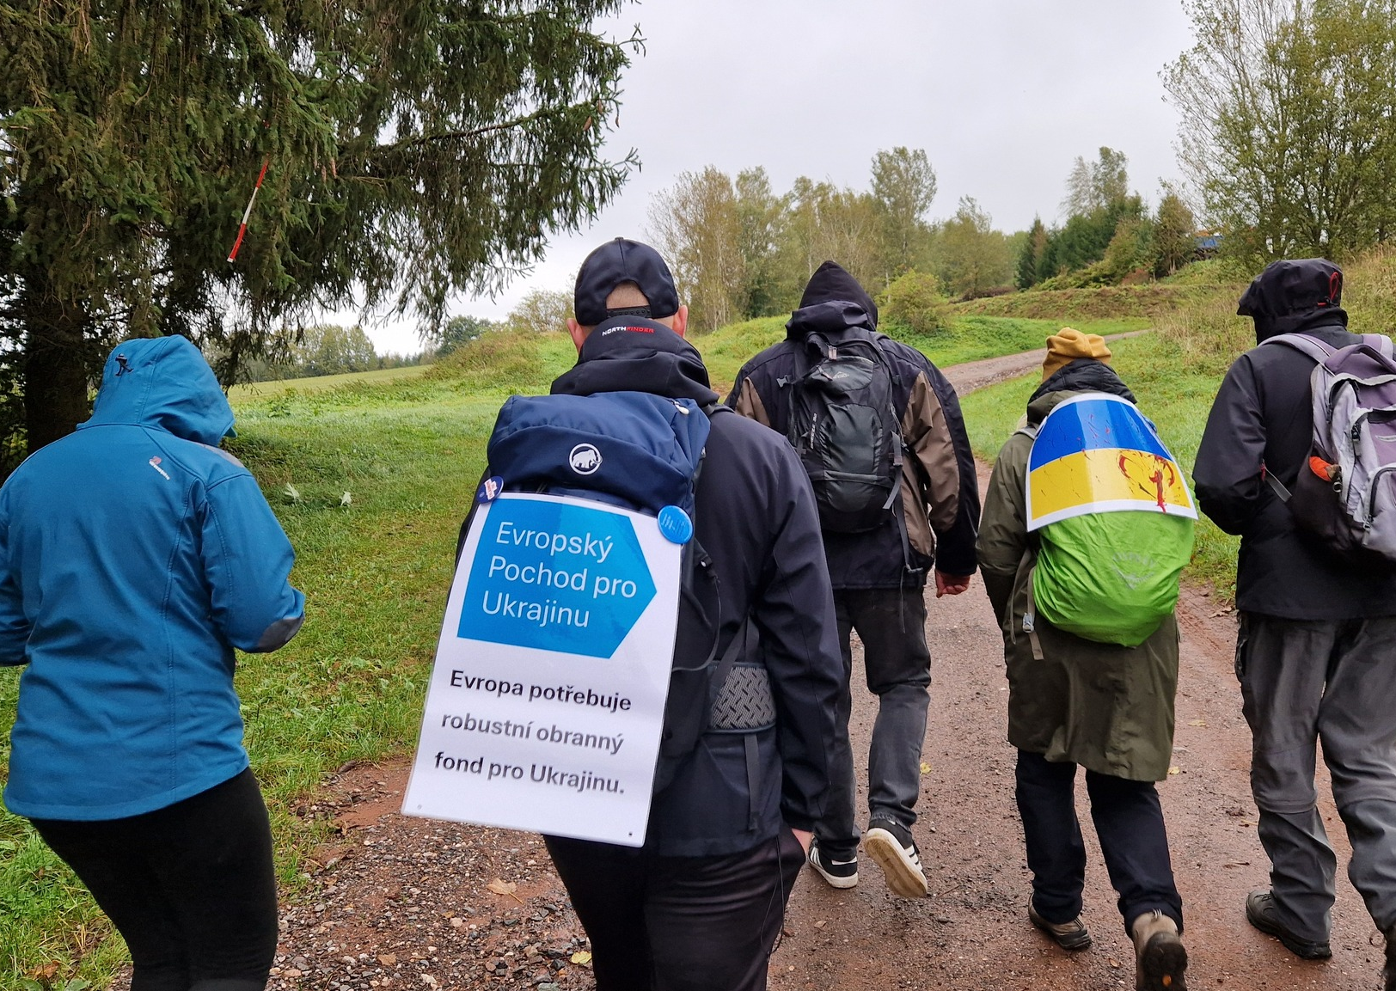
European March for Ukraine

Slide 2
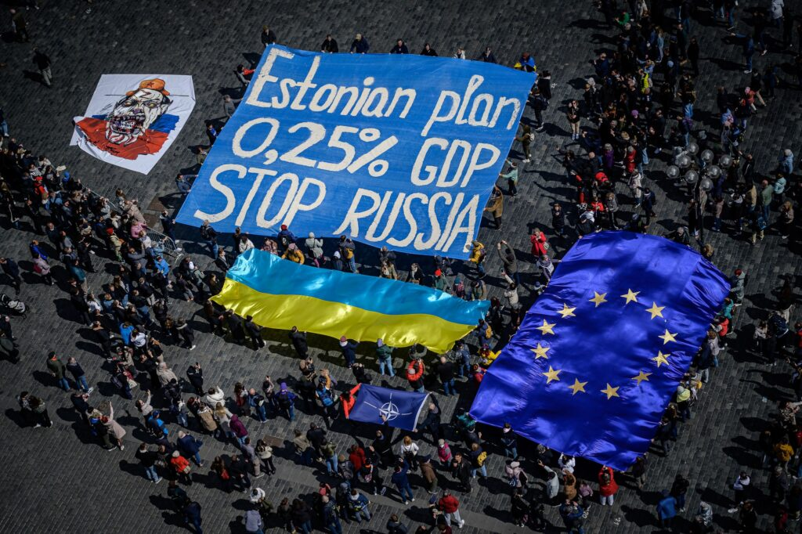
Inspiration and pilot marches
We are following our previous larger event – Estonian plan for Ukraine flashmob in Prague.
And 2 pilot marches in cooperation with initiative across Czech republic in October.
3-day march from Česká Lípa to Prague.
March from Trutnov to Hrádeček (cottage of Václav Havel) this time dedicated to Ukraine.

Slide 3
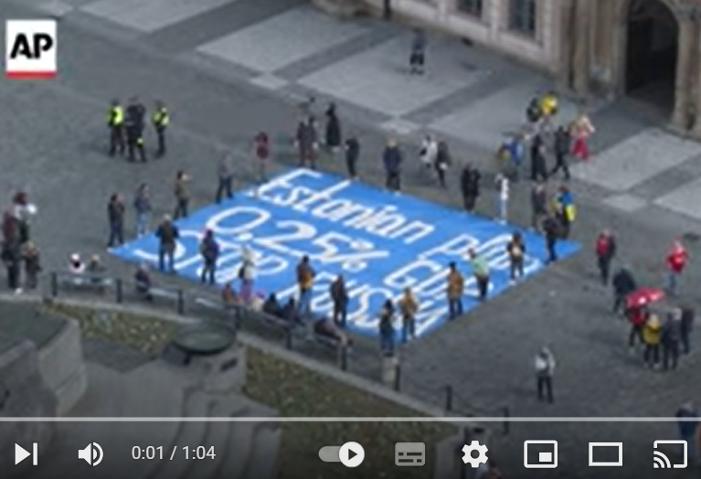
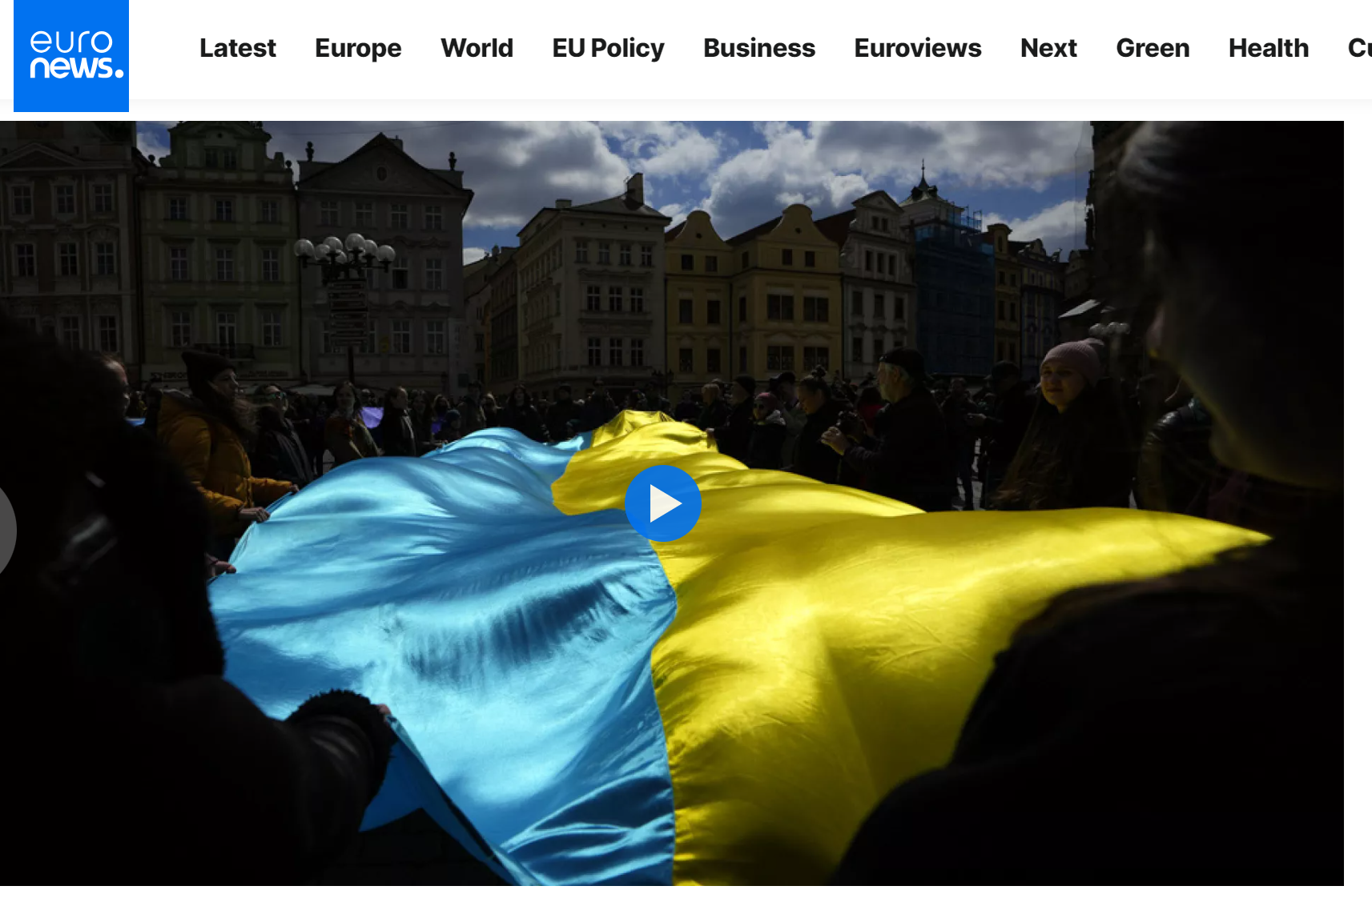
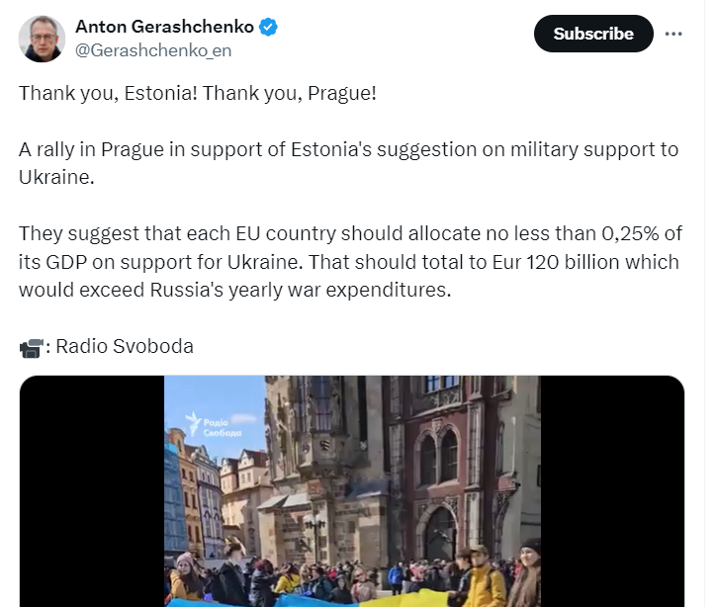
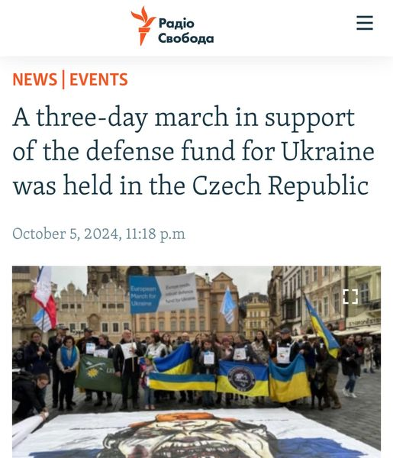
Pilot events in news:
Sources: FB European March for Ukraine / Estonian plan event

Slide 4
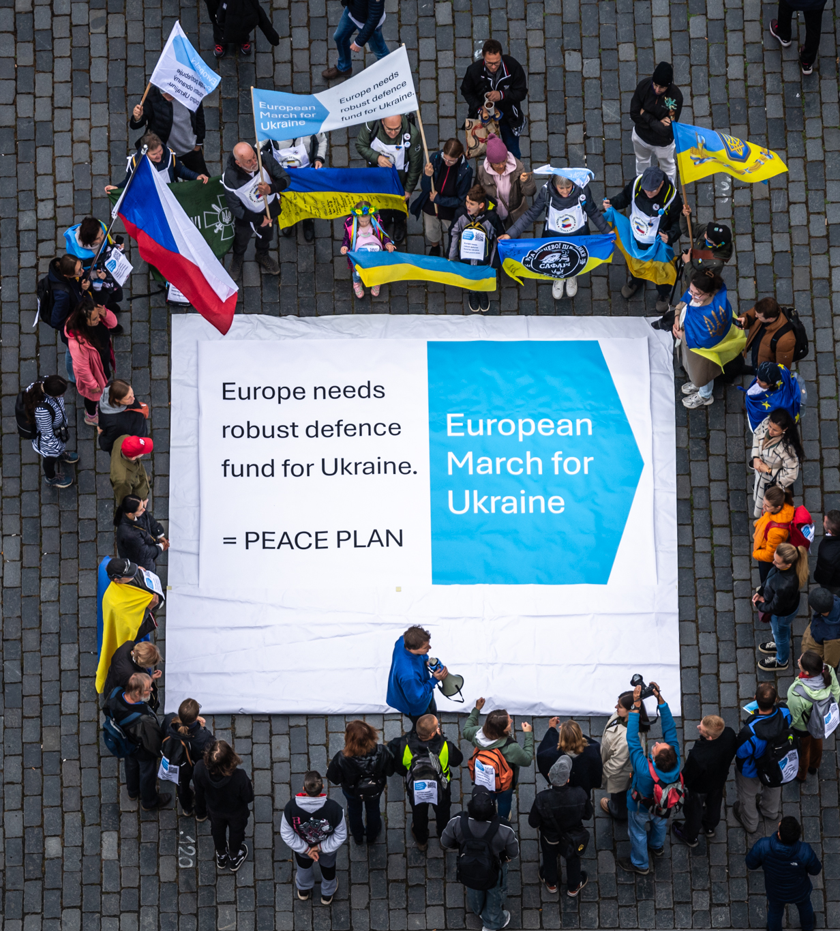
Goal of European March for Ukraine
We promote the idea that European countries should create robust joint defense fund for Ukraine = for Europe.
We shall use detterence by economical power – as Estonian plan says (0,25% western GDP per year as military support of Ukraine). European countries can borrow such amount (100B euro) on financial markets as they did after pandemic (800B euro). Russia cannot do this and is economically much smaller. We need to wake up Europe, because this plan needs to be talked – and put in place.
This is realistic path for peace and in line with Estonian plan and Draghi proposal.

Slide 5
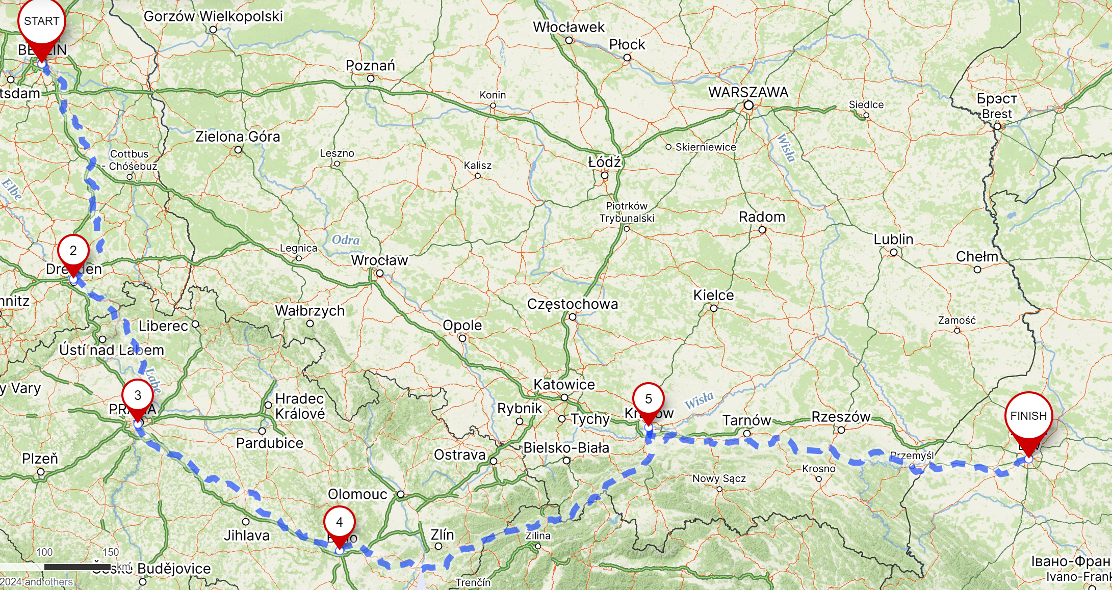
Preliminary route of the proposed long march (from Berlin to Lviv) – 1554 km, up to 2 months of walking
Link to online draft tour: https://en.mapy.cz/s/kakohasasu

Slide 6
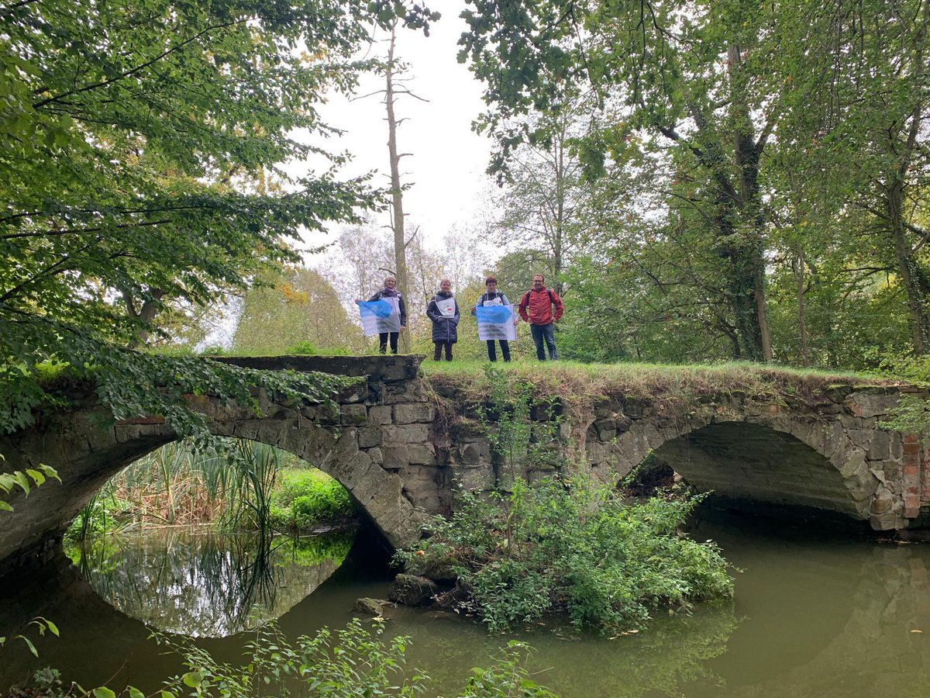
Why do we propose this strategy of long march?
Because we urgently need to bring public attention in Europe to the fact that war can and be stopped, Ukraine and freedom preserved, if Europe will finally use its financial strength.
Long march when somebody walks very long distance (with support of others) is challenging and therefore very strong story. Something like this was done in the past for even longer distances and it is a way how to efficiently signal the following: citizens in Europe understand the only way to stop Russian war is by our combined economical power = strong defence fund for Ukraine.

Slide 7
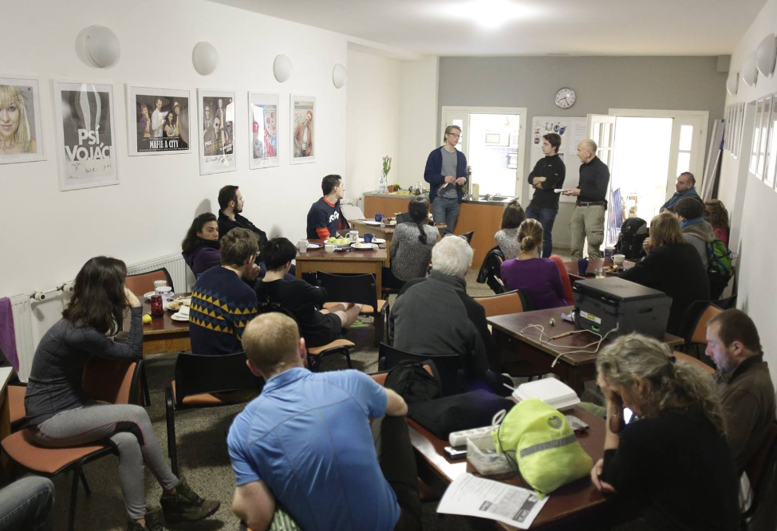
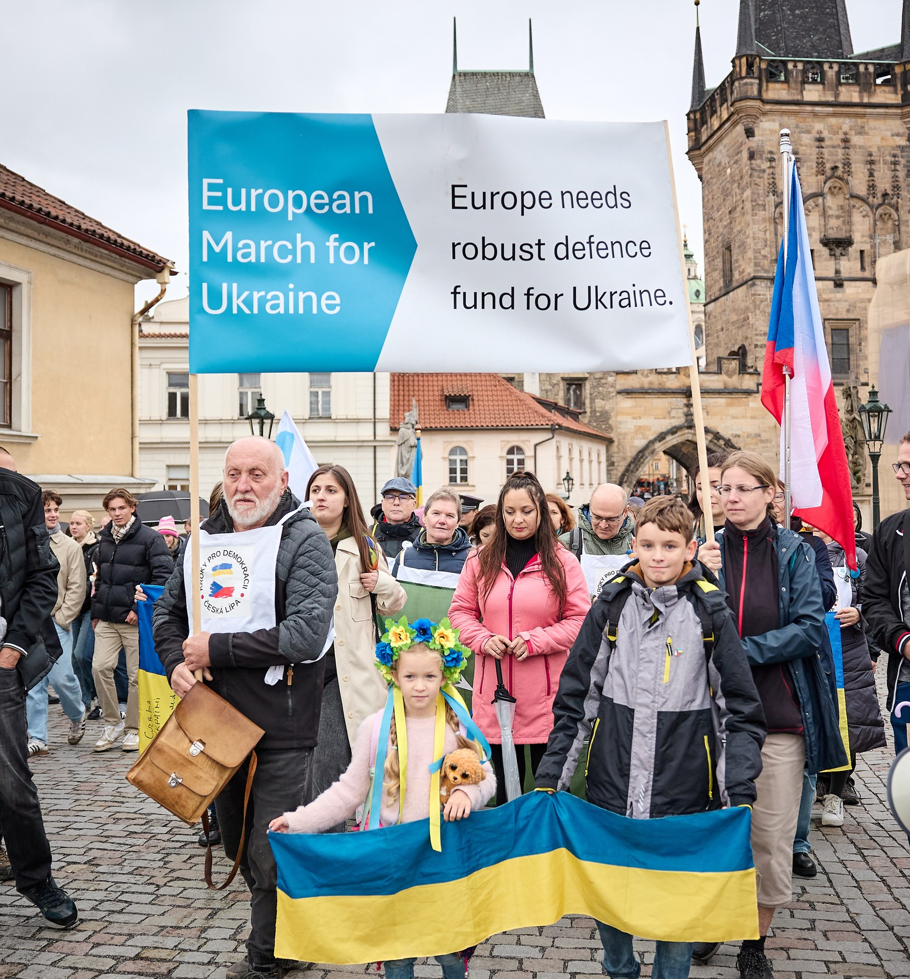
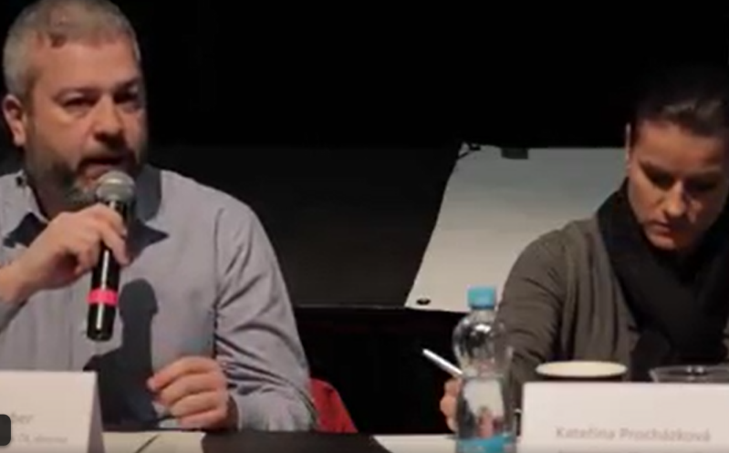
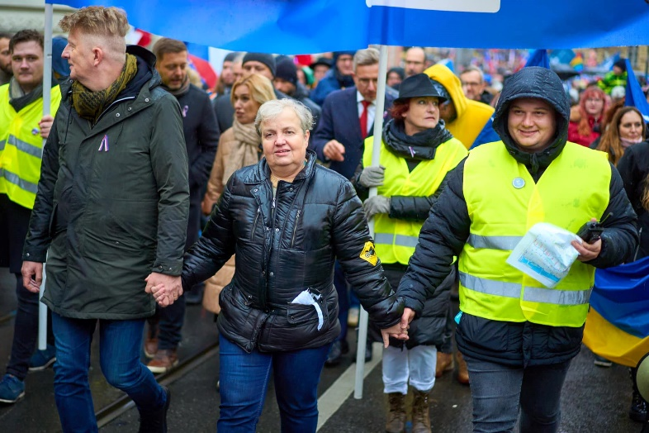
Ideas for stops on the way - European March for Ukraine
Press conferences
Street marches / city rallies
Panel discussions
March pictures in nature
Walks with well-known people

Slide 8
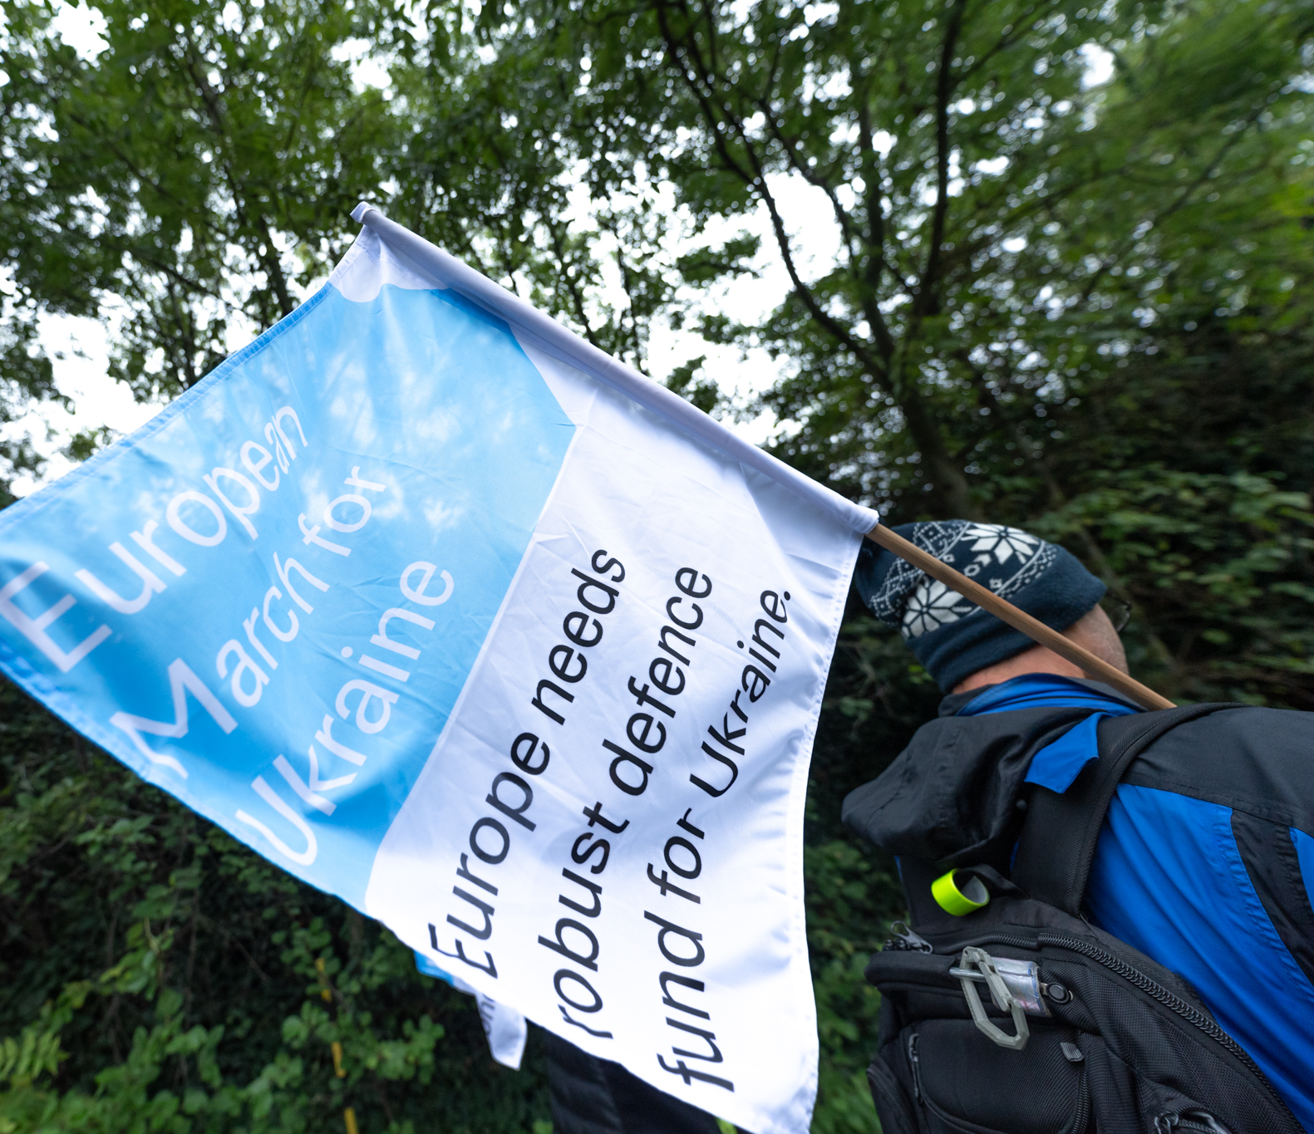
European March for Ukraine: main features
Main advantage: interesting idea almost for everyone. It can really raise awareness and help improve defense of Europe (Ukraine at the frontline) in critical times. It is a powerful tool, fresh for public and media – bringing stories of participants and their motivation.
Concerns and countermeasures: We are looking for long distance walkers, EU citizens - to find someone who will walk the long distance. It is a long journery (1550 km, approx. up to 2,5 months of walking when every day average is 20 km) but we will help to crowdfund expenses for sleeping and support along the way by joining of other people, bring public attention etc.
We will be also looking for organizers and walkers. Please follow our webpage for registering your possible help.

Slide 9
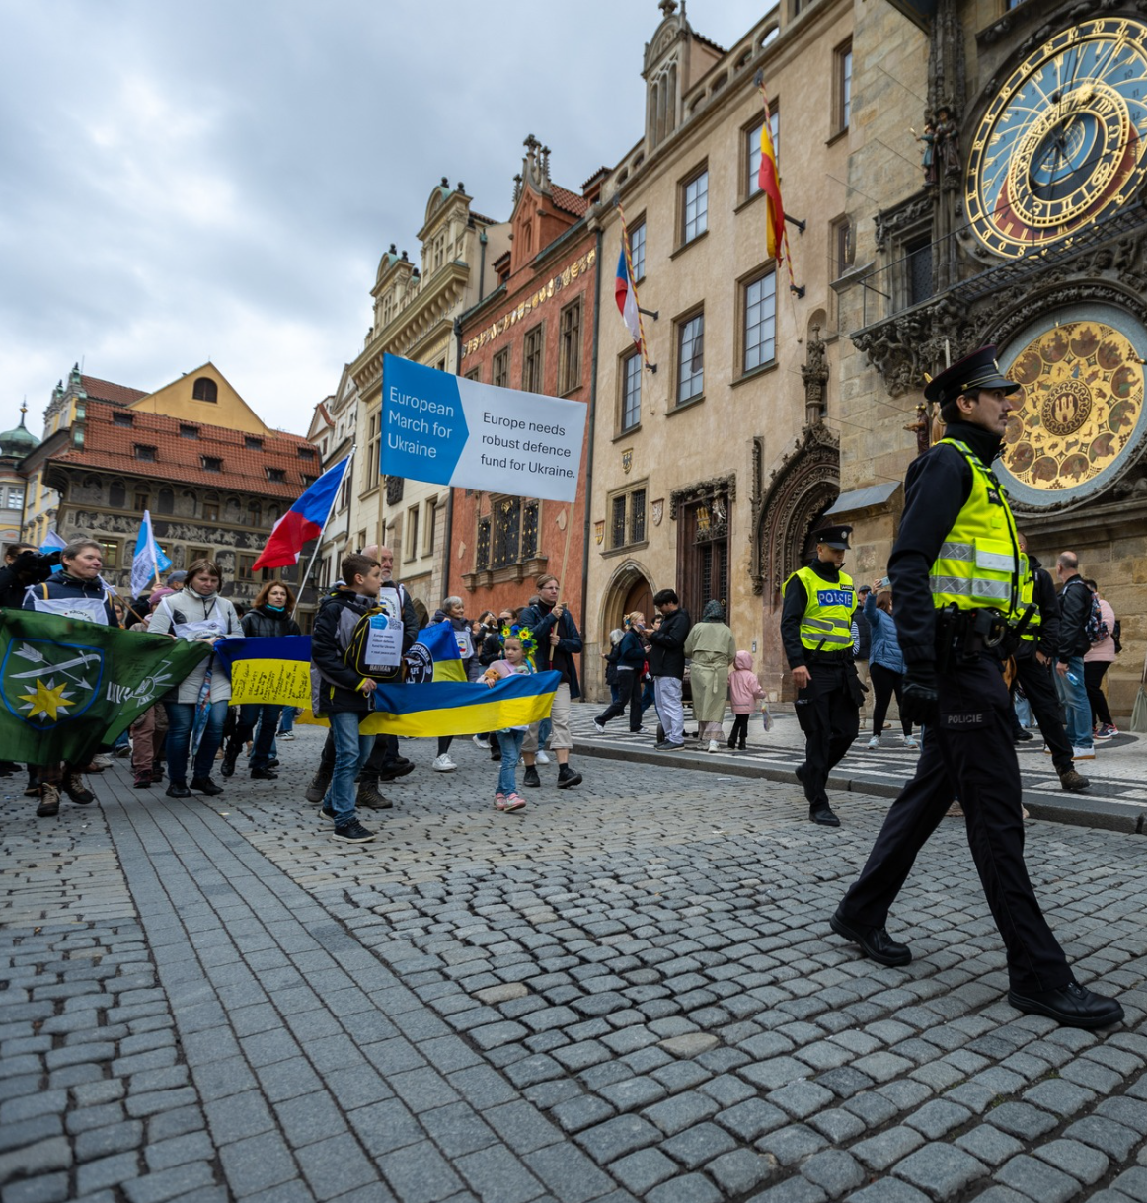
European March for Ukraine 2024/2025
Possible timings:
In winter/spring the latest, probable date is 24.2.2025
Objective:
Support joint fund for European = Ukrainian defense (Estonian plan).
Q&A section on our webpage
Questions and answers - goals and practical matters
Join us:
marchforukraine.net

