Slide 1
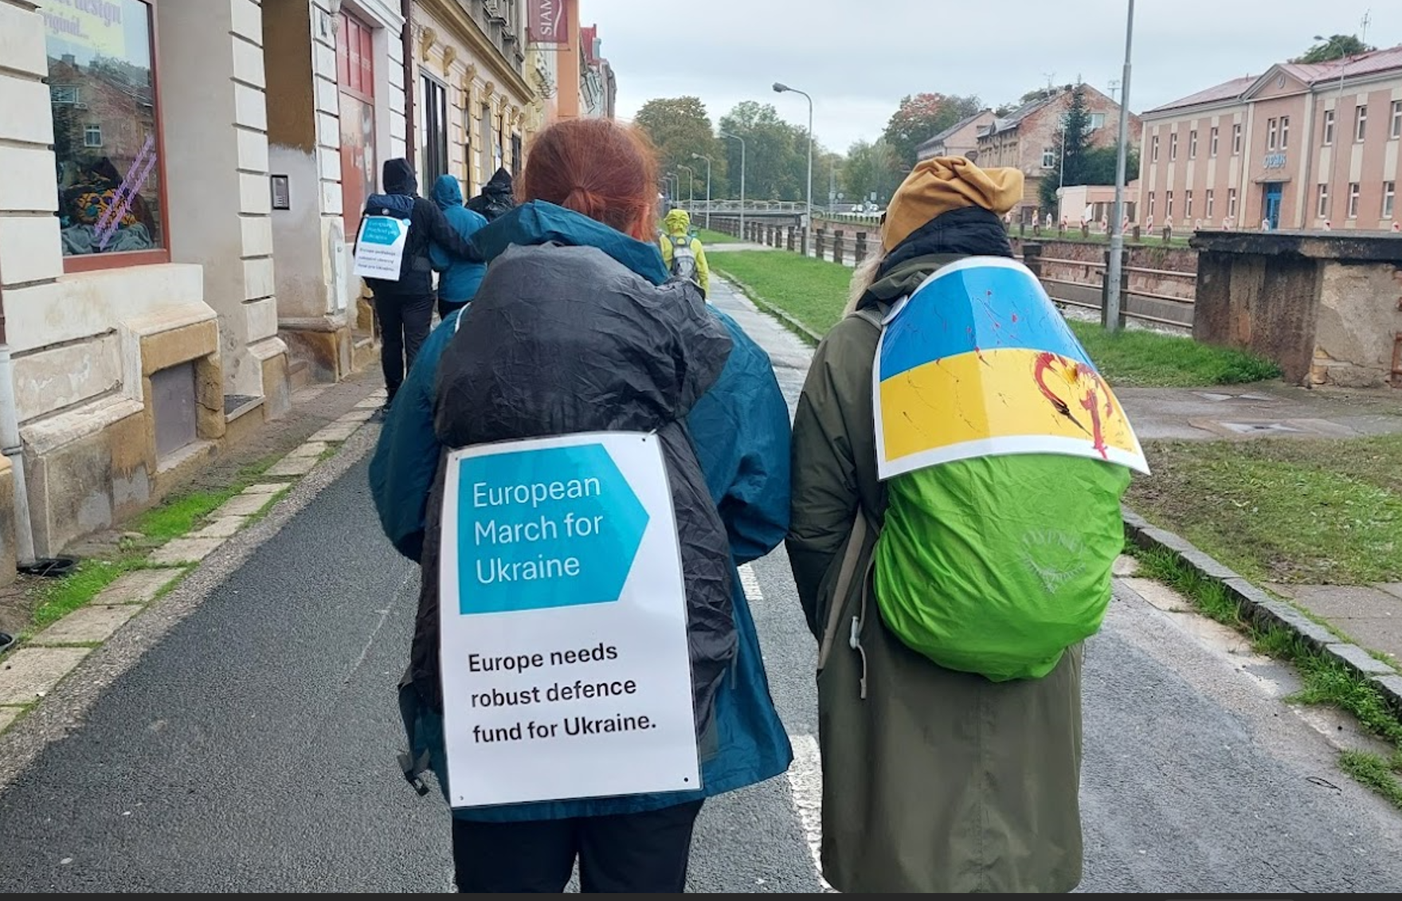
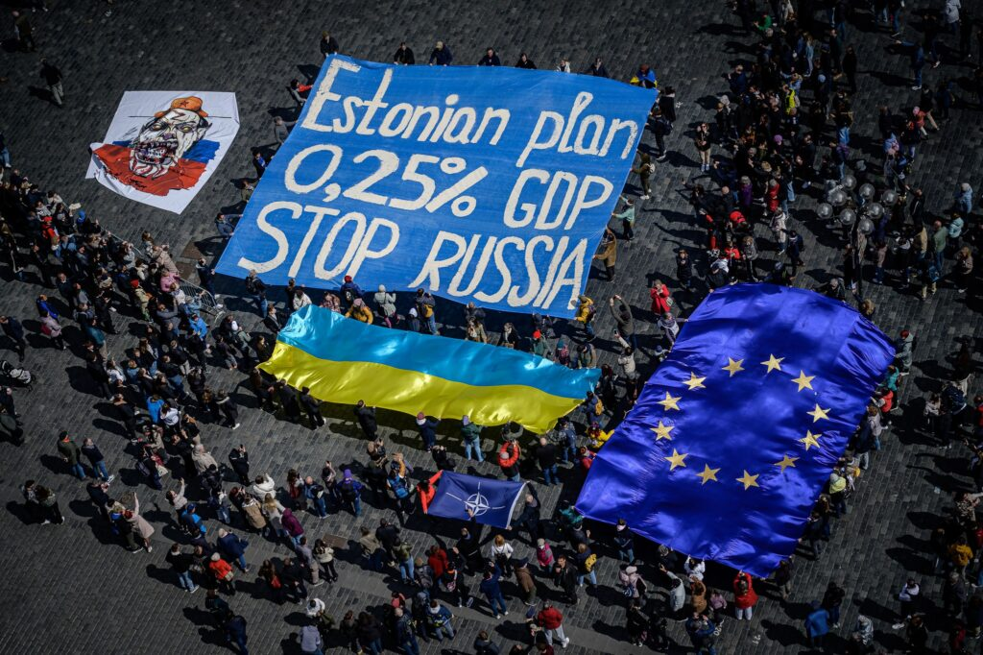
What
Why
Who
When
European Initiative for a Joint Defense Fund to Support Ukraine.
The EU's economy is over 8 times larger than Russia's, yet it doesn't fully leverage its economic power to support Ukraine. The Estonian plan proposes joint debt (Eurobonds) for defense funding, especially urgent post-U.S. elections. Plan is for 100B euro/year (0,25% of western GDP).
Citizens in Prague groups of CZ/UA (Občanský rozcestník, Hlas Ukrajiny) + EU / around 24.2.2025.
How
OPTION A - European March for Ukraine
Walk Berlin to Lviv (over 2 months) to promote the idea in broader EU public space.
Condition: find long-distance walkers.
OPTION B – Other ideas supporting above mentioned objective.
Walks or other actions with politicians, well-known people.
Visual events, Public assemblies with sufficient attendance and support.
Web, presentation, Q&A: marchforukraine.net

